Slide 1
5 - Probability
NPTEL Lectures Link:
1. Introduction to Probability – 1 : https://www.youtube.com/watch?v=yr7zgeJ_XTA&list=PLLy_2iUCG87CNafffzNZPVa9rW-QmOmEv&index=7
2. Introduction to Probability – 2 :
https://www.youtube.com/watch?v=oYRKXOsgPEM&list=PLLy_2iUCG87CNafffzNZPVa9rW-QmOmEv&index=8
Law of Addition
Law of Multiplication
Combination formula
Conditional Probability
Independent events and mutually exclusive events
Computing the contingency table to solve the problems on probability
Condition for independent events
Revision of Probabilities : Baye’s Rule
Some solved examples

Slide 2
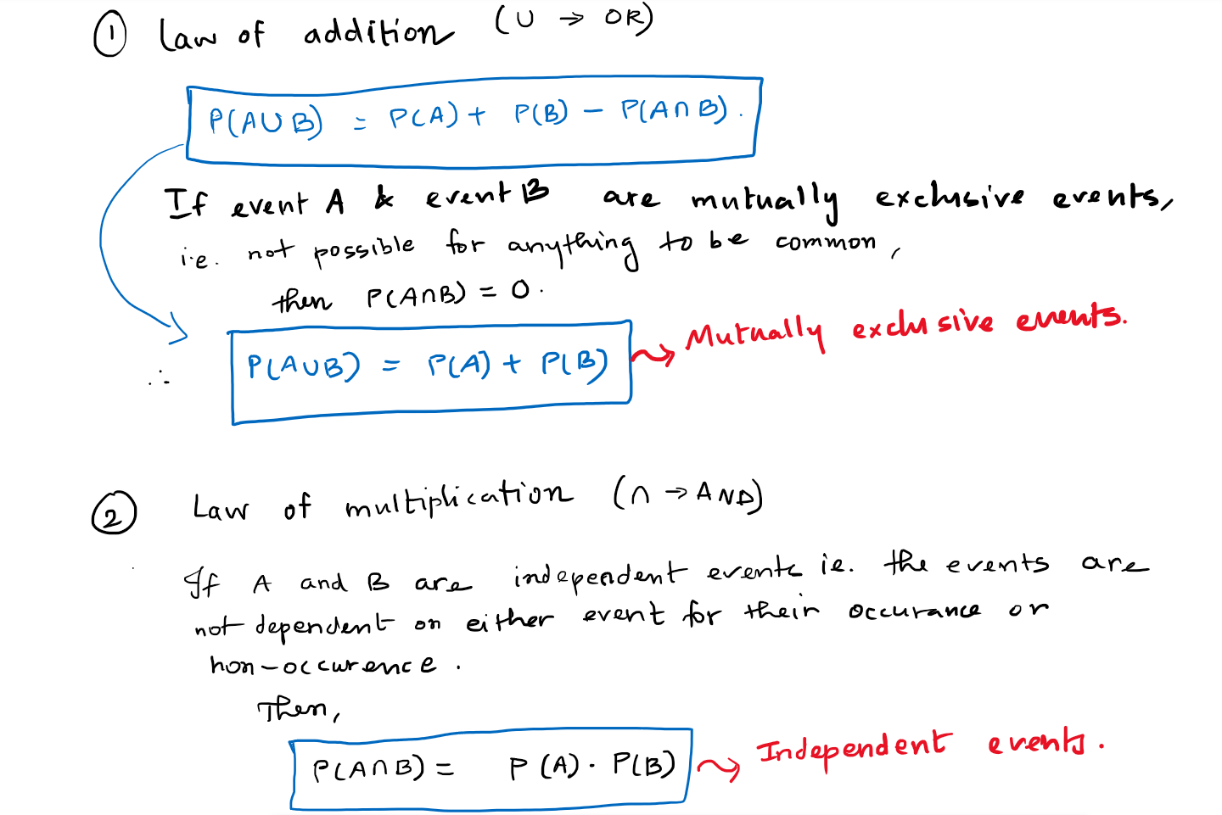

Slide 3
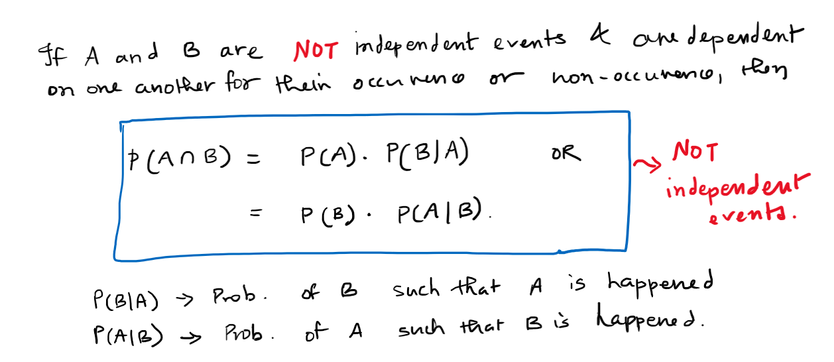

Slide 4
Combination Formula → Khan Academy → https://www.youtube.com/watch?v=p8vIcmr_Pqo

Slide 5
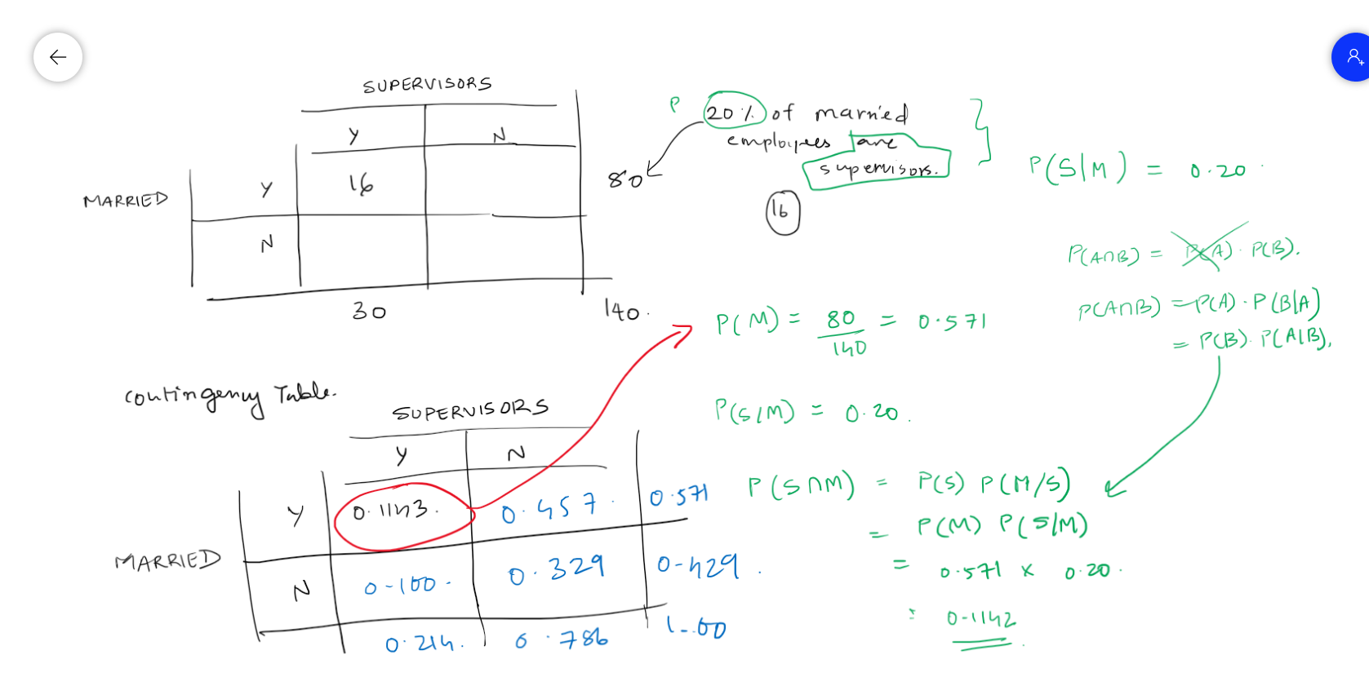

Slide 6
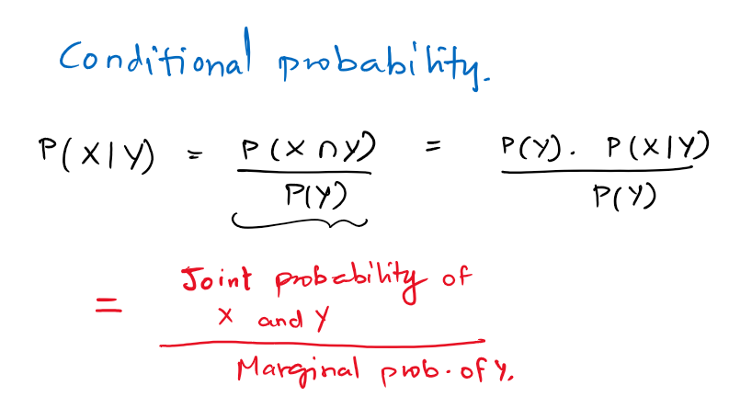








Slide 7
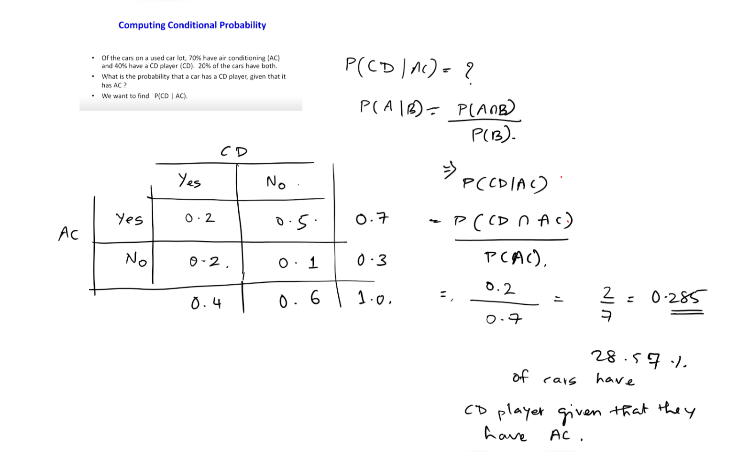




Slide 8
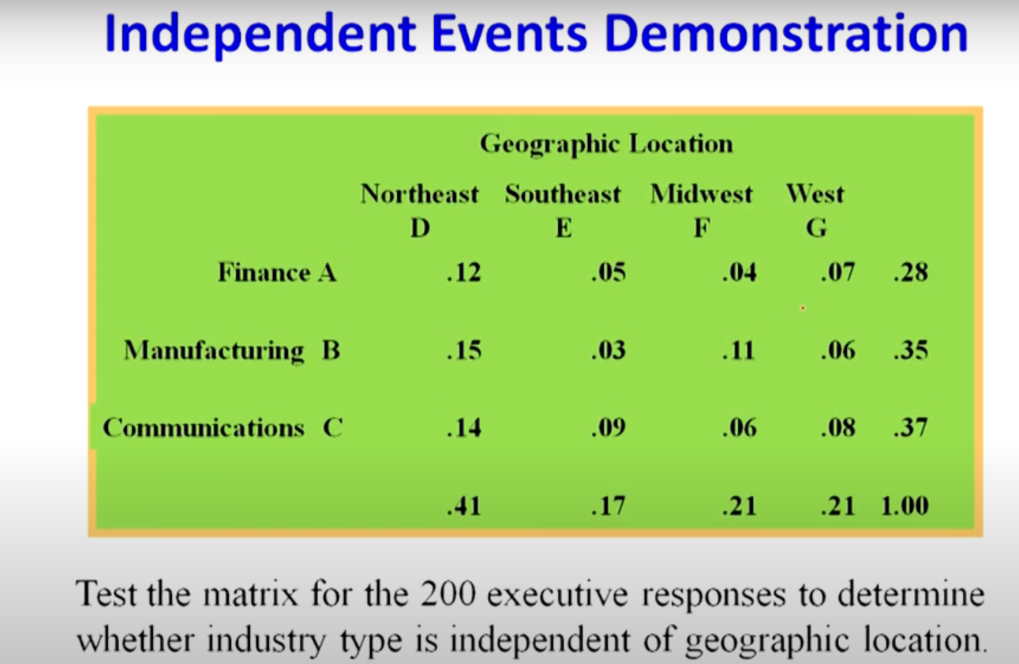














Slide 9
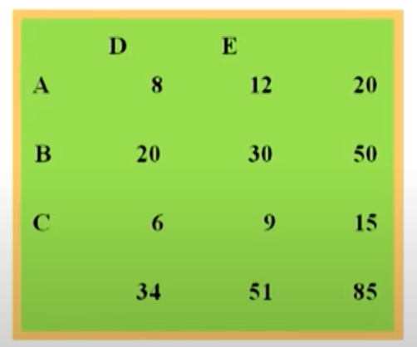



















Slide 10
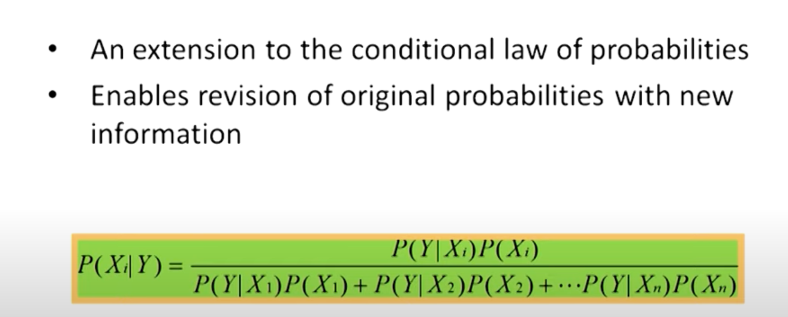




Slide 11















Slide 12
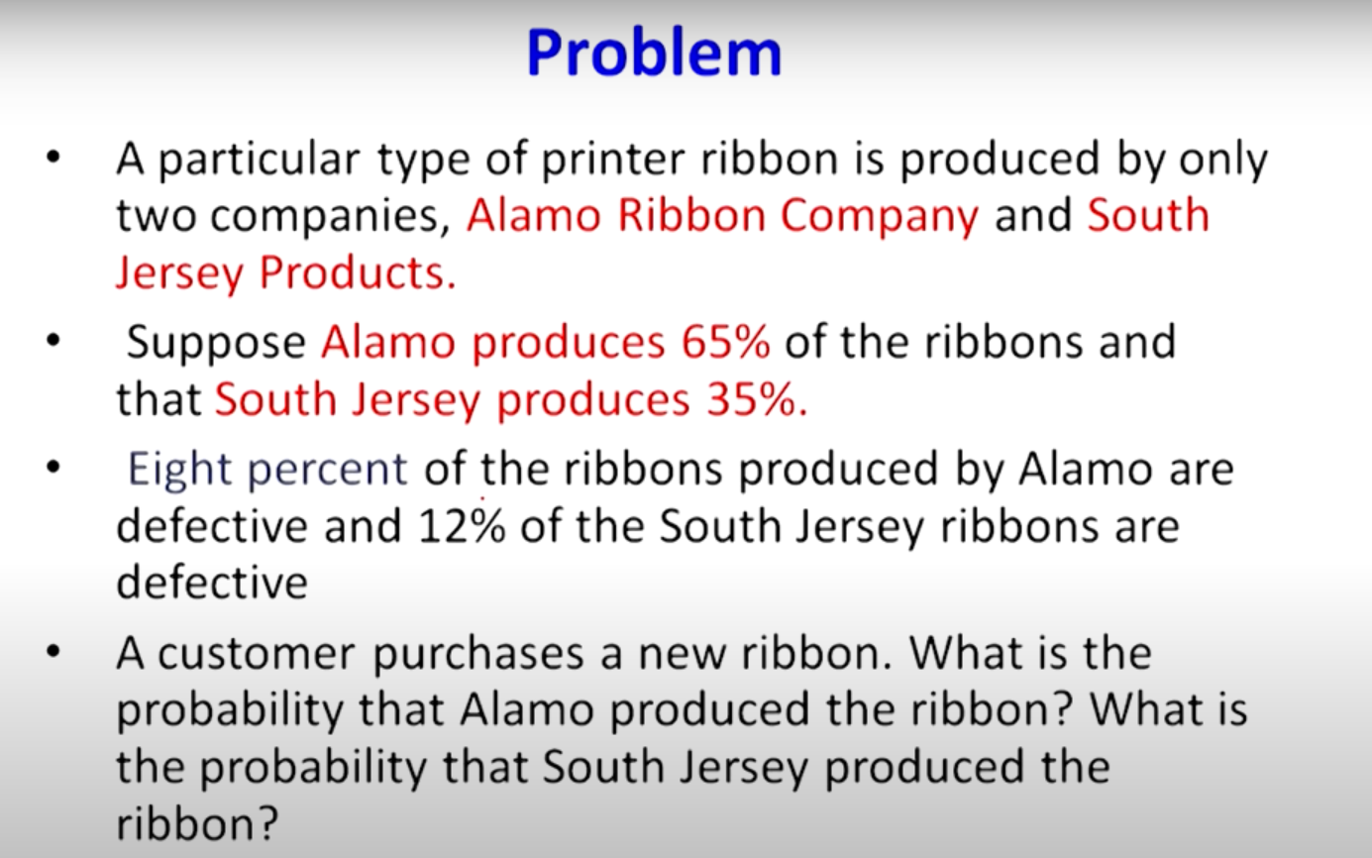



Slide 13



